Slide 1
AGILE SOFTWARE DEVELOPMENT ENGINEERING

Slide 2
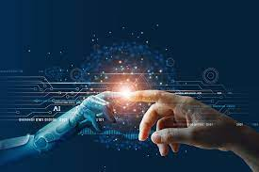
ARTIFICIAL INTELLIGENCE: AI is a intelligence demonstrated by the machine where the human intelligence is put into the machine. In computer science, the field of artificial intelligence as such was launched in 1950 by Alan Turing.

Slide 3
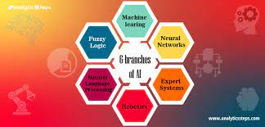
BRANCHES OF ARTIFICIAL INTELLIGENCE:

Slide 4

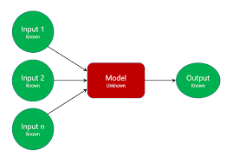
MACHINE LEARNING: Machine learning means making the computers to learn like human beings. We give input and output to the machine leaning algorithm and it builds a model. It predicts the future.

Slide 5
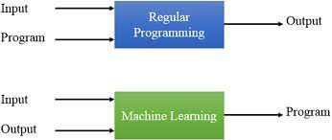
MACHINE COMPUTER PROGRAMING: We give input and output. It will be derived by the program. Example: x = 1 2 3 4 5 Y=2X Y = 2 4 6 8 10 REGULAR COMPUTER PROGRAMMING: We give input and program. It will be give output. Example: x= 1 2 3 4 { y=2x}= 2 4 6 8

Slide 6
Features,Labels,Models: X=2F(x)=4…..Input2Output X=3F(x)=6 X=4F(x)=8 X=5F(x)=10 WhatisX=10? Ans:20 F(x)=2xIstheModels InputsarecalledFeatures. OutputarecalledLabels. FunctioniscalledModels

Slide 7
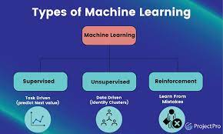
TYPES OF MACHINE LEARNING:

Slide 8
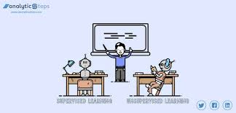
Supervised Learning: 1.Learning from others is called Supervised Learning. 2.Supervised learning will have features and labels. There are two algorithms:- 1.Regression 2.Classification

Slide 9
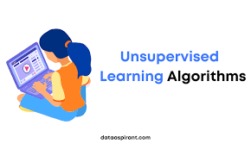
Unsupervised learning: Learning on our own is called UNSUPERVISED LEARNING.

Slide 10
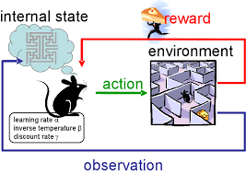
Reinforcement Learning: Machine Learning method in which the user is rewarded for the desired behaviour or punished for the undesired behaviour.

Slide 11
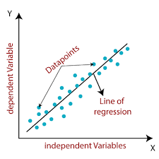
Explain Different Machine learning algorithms with example: Regression Algorithm Regression Algorithm means which have a continuous data. In regression we use only: 1. Linear regression 2.Non-Linear regression

Slide 12
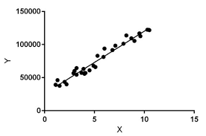
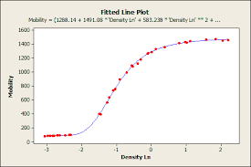
Regression Algorithm: Linear regression Non-linear regression

Slide 13
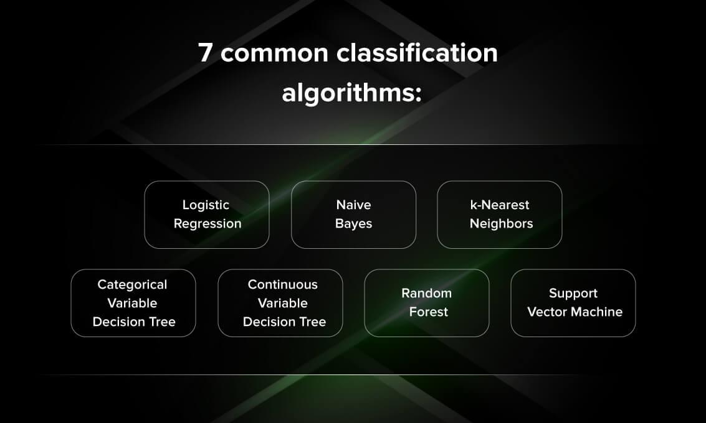
Classification Algorithm: Classifying the data either one like Yes Or No, True Or False etc. In classifying we use: 1.Logical Regression. 2.Decision Tree.[DT] 3.Random Forest.[RF] 4.K Nearest Neighbour[KNN] 5.Support Vector Machine[SVM] 6.Naïve Bayes

Slide 14
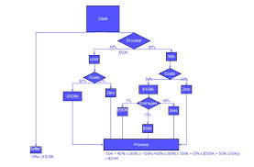
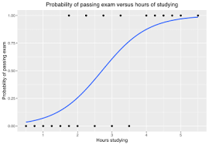
Logistic Regression Decision Tree

Slide 15
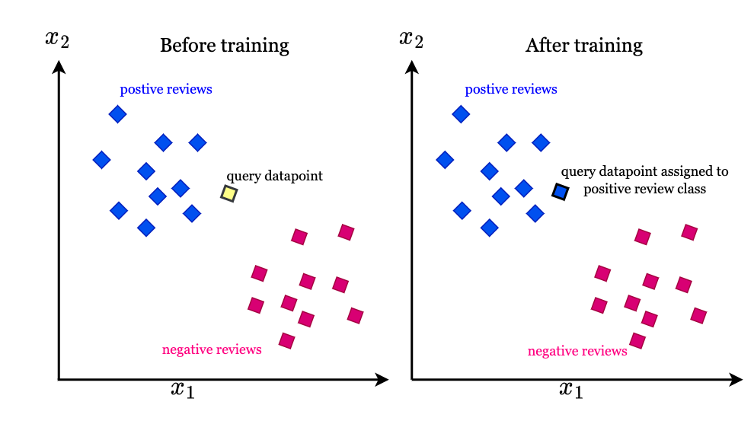
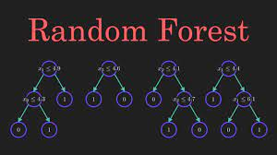
Random Algorithm K Nearest Neighbour

Slide 16
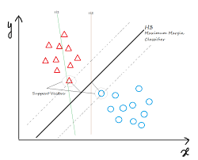
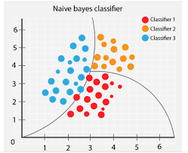
Support Vector Machine(SVM) Naïve Bayes

